Slide 1

STRUCTURED CONCURRENCY
2025-11-27
KOTLIN CO-ROUTINES, JAVA PROJECT LOOM
Audrius Mičiulis
https://app-studio.lt

Slide 2
KOTLIN COROUTINES

Slide 3
CONTENT
Kotlin Coroutines
Structured Concurrency
Project Loom

Slide 4
ANDROID. UI THREAD
All UI related changes must be executed on UIThread
Android application runs Looper that have infinite loop and processes Messages in queue
If the Message (Runnable) is running for a long time UI “freezes”
You should run long lasting processes in background thread, but UI still needs to be updated on UIThread

Slide 5
ANDROID. WHAT PROBLEM WE WANT TO SOLVE
Performance can be increased by executing multiple tasks (e.g. HTTP requests) simultaneously
Code that uses callbacks or threads are not readable

Slide 6
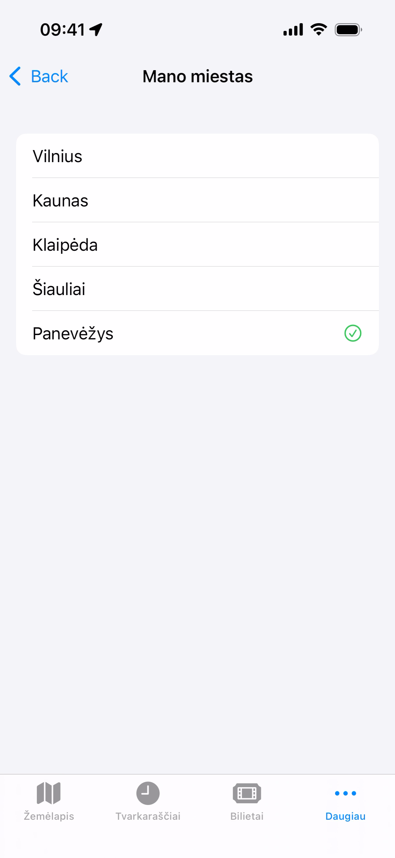

Slide 7
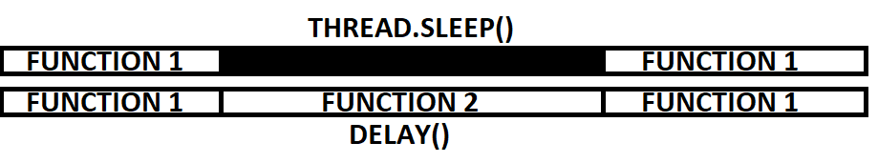
BLOCKING VS SUSPENDING
Thread.sleep(1000) blocks execution of code for 1 second
delay(1000) pause execution of current function and allows other code to execute

Slide 8
SUSPEND FUNCTIONS
Suspend functions can suspend its executions at suspension points
Suspension points are marked in IntelliJ IDEA
Suspend functions can only be called from other suspend functions or coroutines
Regular functions can be called from suspend functions
Suspend functions can be called on main thread

Slide 9
CO-ROUTINES
Co-routine = Cooperative routine
Most important libraries that are using them are Retrofit (HTTP client) and Room (database client)

Slide 10

TRAILING LAMBDA
var list = List.of(1, 2, 3, 4, 5); list.forEach(i -> { System.out.println(i); System.out.println(i * 2); });
val list = listOf(1, 2, 3, 4, 5) list.forEach { i -> println(i) println(i * 2) }
scope.launch { println("start") delay(Duration.ofSeconds(1)) println("finish") }

Slide 11
RUN BLOCKING
runBlocking() is coroutine builder that does not require coroutine scope
It blocks the current thread until all of its code is completed
It is useful for starting coroutines in places where you need to wait for them, such as main functions in console applications or within unit tests

Slide 12
SIMPLE EXAMPLE
fun main() { runBlocking { println("Start") delay(Duration.ofSeconds(2)) println("Finish") } }

Slide 13
COROUTINE BUILDERS. LAUNCH
fun main() { runBlocking { launch { println("Job 1 started") delay(Duration.ofSeconds(2)) println("Job 1 finished") } launch { println("Job 2 started") delay(Duration.ofSeconds(1)) println("Job 2 finished") } println("Main code started") delay(Duration.ofMillis(10)) println("Main code finished") } }

Slide 14
COROUTINE BUILDERS. ASYNC
fun main() { runBlocking { val job1 = async { println("Job 1 started") delay(Duration.ofSeconds(2)) println("Job 1 finished") return@async "Job 1 Result" } val job2 = async { println("Job 2 started") delay(Duration.ofSeconds(1)) println("Job 2 finished") return@async "Job 2 Result" } println("Main code started") val results = listOf(job1, job2).awaitAll() println("Results: $results") println("Main code finished") } }

Slide 15
LAUNCH VS ASYNC
If you need to return result use async. Do not write to shared mutable state with launch
launch returns Job, async return Deffered
use join on Job to wait for coroutine to finish
use await() on Job or awaitAll() on Deffered to wait for coroutine(s) to finish
In either way parent coroutine is suspended to wait for result
async does not re-throw exceptions until await is called

Slide 16
COROUTINE BUILDERS. LAZY
fun main() { runBlocking { val job1 = launch(start = CoroutineStart.LAZY) { println("Job 1 started") delay(Duration.ofSeconds(2)) println("Job 1 finished") } val job2 = launch(start = CoroutineStart.LAZY) { println("Job 2 started") delay(Duration.ofSeconds(1)) println("Job 2 finished") } println("Main code started") job1.start() delay(Duration.ofSeconds(3)) println("Main code finished") job2.start() } }

Slide 17
ALL COROUTINES EXECURED ON SAME THREAD
fun main() { runBlocking { launch { println("Job 1 started on ${Thread.currentThread().name}") delay(Duration.ofSeconds(2)) println("Job 1 finished on ${Thread.currentThread().name}") } launch { println("Job 2 started on ${Thread.currentThread().name}") delay(Duration.ofSeconds(1)) println("Job 2 finished on ${Thread.currentThread().name}") } println("Main code started on ${Thread.currentThread().name}") delay(Duration.ofMillis(10)) println("Main code finished on ${Thread.currentThread().name}") } }

Slide 18
SUSPEND FUNCTIONS
fun postItem(item: Item) { val token = requestToken() val post = createPost(token, item) processPost() }
fun postItem(item: Item) { requestToken { token -> val post = createPost(token, item) processPost() } }
fun postItem(item: Item) { requestToken { token -> createPost(token, item) { processPost() } } }

Slide 19
DECOMPILED SUSPEND FUNCTION
suspend fun postItem(item: Item) { println("Job $label started.") delay(Duration.ofMillis(millis)) println("Job $label finished.") }

Slide 20
DECOMPILED SUSPEND FUNCTION
suspend fun job(label: String, millis: Long) { println("Job $label started.") delay(Duration.ofMillis(millis)) println("Job $label finished.") } fun jobDecompiled(label: String, millis: Long, contination: Continuation<Any>) { when (continuation.label) { 0 -> { println("Job $label started.") } 1 -> { println("Job $label finished.") } } }
Callback

Slide 21
COROUTINES VS THREADS
Switching between threads are very expensive
Passing parameters between threads is complicated

Slide 22
COROUTINE SCOPE
CoroutineScope contains CoroutineContext
CoroutineContext contains Elements
Name
Dispatcher
Job
ErrorHandler
You can pass multiple Elements to CoroutineScope (at least one)

Slide 23
COROUTINE SCOPE
Coroutines created in the same scope forms a hierarchy
In Android coroutine scopes are usually created by frameworks
GlobalScope – lives as long as your application is alive
ViewModelScope – lives as long as your screen is in navigation hierarchy, executes operations on main thread
If user navigates back from the screen ViewModel is terminated and all coroutines cancelled automatically

Slide 24
COROUTINE SCOPE
You can create another scope inside coroutine scope in needed using coroutineScope{} function
coroutineScope{} does not return until nested coroutines inside are completed

Slide 25
COROUTINE NAME
Can identify coroutine in logs
Useful for debugging

Slide 26
DIPATCHER
Dispatchers.MAIN (Dispatchers.MAIN.immediate)
Send runnable to Main Looper
You need suspension points to allow other tasks to execute
yield suspense current function and moves code to the end of Main Looper
Dispatchers.Default
Executed on background thread
Uses thread pool, with a number of threads equal to CPU cores
CPU intensive work

Slide 27
DIPATCHER
Dispatchers.IO
Executed on background thread
Uses thread pool, with up to 64 threads
Used for reading and writing to disk, network calls, database access
Optimized for tasks that involve waiting for external resources
Use withContext to switch Dispatchers at any time
Use withTimeOut to cancel coroutine if it does not complete in time

Slide 28
JOB
Job
If coroutine fails (exception is thrown) then all parent, child and sibling coroutines are cancelled (“all-or-nothing”)
e.g., sorting a big array on multiple coroutines, if at least one part fails, siblings should be cancelled immediately
SupervisorJob
If coroutine fails then only child coroutines are cancelled
e.g., finding flying options from one airport to another

Slide 29
ERROR HANDLER
try/catch block outside coroutine will not catch exception inside coroutine
If you can recover from exceptional situation, do it inside coroutine
If exceptions is not handled inside coroutine, coroutine fails and exceptions is propagated in job hierarchy

Slide 30
ERROR HANDLER
You can write your own exception handler and pass it to Scope or top level Job constructor
Exception is handled, but coroutine still fails and depending on Job type other coroutines gets cancelled or not

Slide 31
ERROR HANDLER
coroutineScope rethrows exceptions. It is useful when we want to catch exceptions that are thrown inside suspend functions
async doesn’t throw exception immediately, but only when await is called

Slide 32
CANCELLATION
Use cancel() to cancel coroutine
Use cancelAndJoin() to cancel coroutine and suspend until coroutine is complete
If coroutine is cancelled, suspend functions (e.g., delay) will throw CancellationException

Slide 33
CANCELLATION
It’s our responsibility to make our code cooperative regarding cancelation
Use ensureActive() to throw CancellationException
Use isActive() to check if coroutine is not cancelled (useful when need to do some clean-up first, but make sure you don’t call any suspension functions in it)
Use withContext(NonCancellable) execute critical code that cannot be cancelled.

Slide 34
STRUCTURED CONCURRENCY

Slide 35
STRUCTURED CONCURRENCY
Every coroutine needs to be started in a logical scope with limited lifetime

Slide 36
STRUCTURED CONCURRENCY
Coroutines, started in same scope forms a hierarchy. A parent job won't complete until all of its children's have completed
Scope
Job-1
Job-2
Job-3
Job-3a
Job-3b

Slide 37
STRUCTURED CONCURRENCY
Cancellation of a parent will cancel its children's. Cancelling a child won’t cancel its parent or siblings.

Slide 38
STRUCTURED CONCURRENCY
If a child coroutine fails, the exception is propagated upwards and depending on the job type, either all siblings are cancelled or not.

Slide 39
CONVENTIONS. THINKS TO REMEMBER
Suspend functions should not block the caller thread. That’s not default, it’s your responsibility to ensure this.
Most popular Android HTTP and Database libraries Retrofit and Room complies to this convention.
Make your coroutines cooperative regarding cancellation
Exceptions can not be handled with try/catch

Slide 40
JAVA

Slide 41
VIRTUAL THREADS

Slide 42
VIRTUAL THREADS
JEP-425: Virtual Threads (Preview) – JDK 19
JEP-436: Virtual Threads (Second Preview) – JDK 20
JEP-444: Virtual Threads – JDK 21

Slide 43
SUMMARY
Introduce virtual threads to the Java Platform. Virtual threads are lightweight threads that dramatically reduce the effort of writing, maintaining, and observing high-throughput concurrent applications.

Slide 44
COMPATIBILITY
General OS Threads are now called Platform Threads
Virtual Threads are lightweight
Supports ThreadLocal, thread interruption

Slide 45
BEHIND SCENES
Shares small pool of actual Platform Threads managed by JVM
Virtual Thread Scheduler decides when to move virtual thread to platform thread

Slide 46
USAGE
Optimized for I/O processing
HTTP requests
Database calls
File read/write
Not very beneficial when doing heavy work (e.g., image processing)
High throughput (scale), but not faster (latency not better)
CPU will not be waisted if thread is waiting

Slide 47
USAGE
Create as much Virtual Threads as you need
Thread Pools are not needed
Thread.currentThread().isVirtual()
Spring Boot 3.2 added support for Virtual Thread (not enabled by default)

Slide 48
SCOPED VALUES

Slide 49
SCOPED VALUES
JEP 429: Scoped Values (Incubator) – JDK 20
JEP 446: Scoped Values (Preview) – JDK 21
JEP-464: Scoped Values (Second Preview) – JDK 22
JEP 481: Scoped Values (Third Preview) – JDK 23
JEP 487: Scoped Values (Fourth Preview) – JDK 24
JEP 506: Scoped Values – JDK 25

Slide 50
SUMMARY
Preferred over ThreadLocal variables
Easy to leak memory if ThreadLocal is not removed at the end of thread lifetime
If not removed same value can be accessed if thread is reused from the pool
Immutable, but you can rebind value
Scoped

Slide 51
USAGE
Allows passing data though sequence of method calls without using method parameters
You can use parameter in deeply nested function
StructuredTaskScope supports inheriting scoped values into subtasks
Multiple scoped values can be chained in one call
ScopedValue.isBound()

Slide 52
PROJECT LOOM

Slide 53
STRUCTURED CONCURRENCY
JEP 428: Structured Concurrency (Incubator) – JDK 19
JEP 437: Structured Concurrency (Second Incubator) – JDK 20
JEP 453: Structured Concurrency (Preview) – JDK 21
JEP 462: Structured Concurrency (Second Preview) – JDK 22
JEP 480: Structured Concurrency (Third Preview) – JDK 23
JEP 499: Structured Concurrency (Fourth Preview) – JDK 24
JEP 505: Structured Concurrency (Fifth Preview) – JDK 25
JEP 525: Structured Concurrency (Sixth Preview) – JDK 26

Slide 54
SUMMARY
Simplify concurrent programming by introducing an API for structured concurrency. Structured concurrency treats groups of related tasks running in different threads as a single unit of work, thereby streamlining error handling and cancellation, improving reliability, and enhancing observability
Improve the observability of concurrent code
Supports nested tasks

Slide 55
API
StructuredTaskScope.open() – creates scope
StructuredTaskScope.ShutdownonFailure()
StructuredTaskScope.ShutdownonSuccess()
scope.fork() – to create subtask
subtask.join() – to wait for result (success or fail)
scope.close() – always waits for all tasks to finish (even if they are cancelled)

Slide 56
JOINERS (ex POLICY)
Joiner.allSuccessfulOrThrow
Joiner.anySuccessfulResultOrThrow
Joiner.awaitAll
Possibility to create your own Joiner
e.g., to do retry

Slide 57
CONFIG
Config.withTimeout()
Config.withName()

Slide 58
CANCELLATION
Cancel propagation
Subtasks must be cooperative regarding cancellation
Cancellation throws InterruptedException()

Slide 59
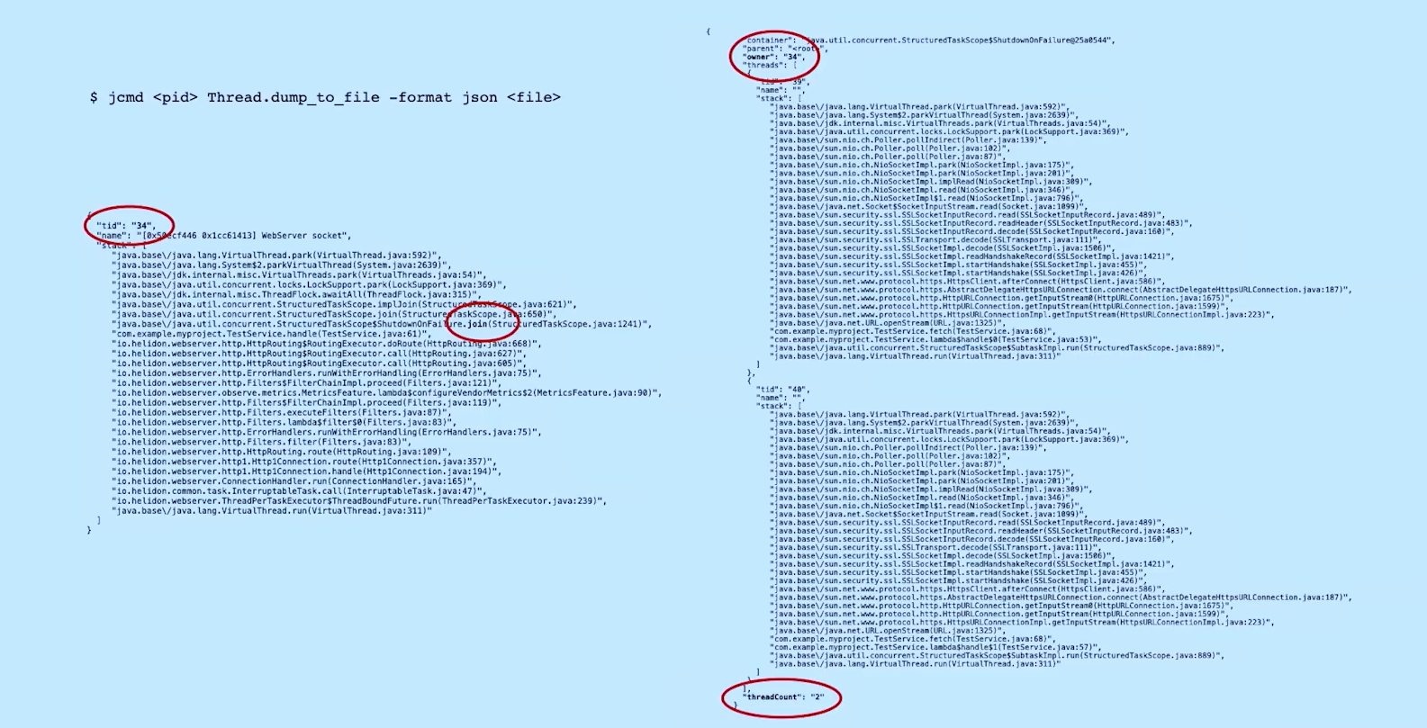
OBSERVABILITY

Slide 60
EXAMPLE
Get partner products
Get products
Return products
Get local products
Get from database
Get local products
Return result
Get from cache

Slide 61
LITERATURE

Slide 62

Lukas Lechner

Slide 63
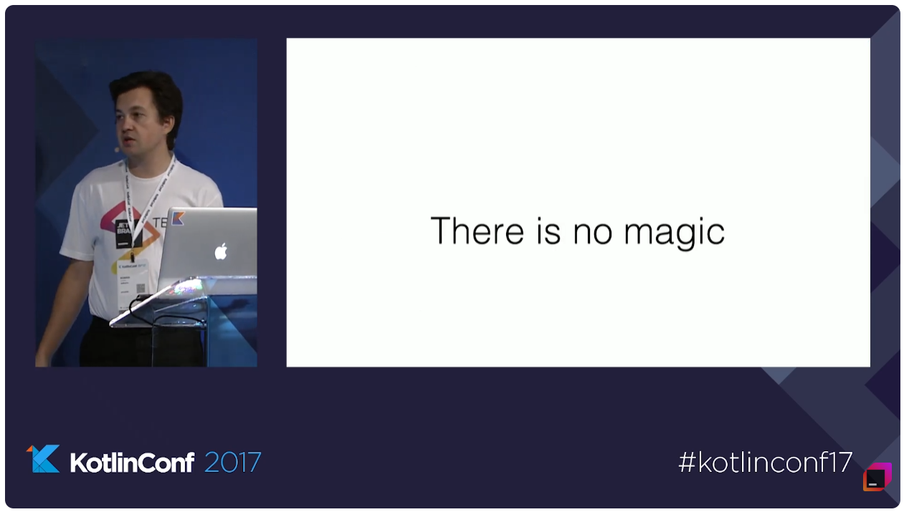
KotlinConf 2017 - Deep Dive into Coroutines on JVM by Roman Elizarov

Slide 64
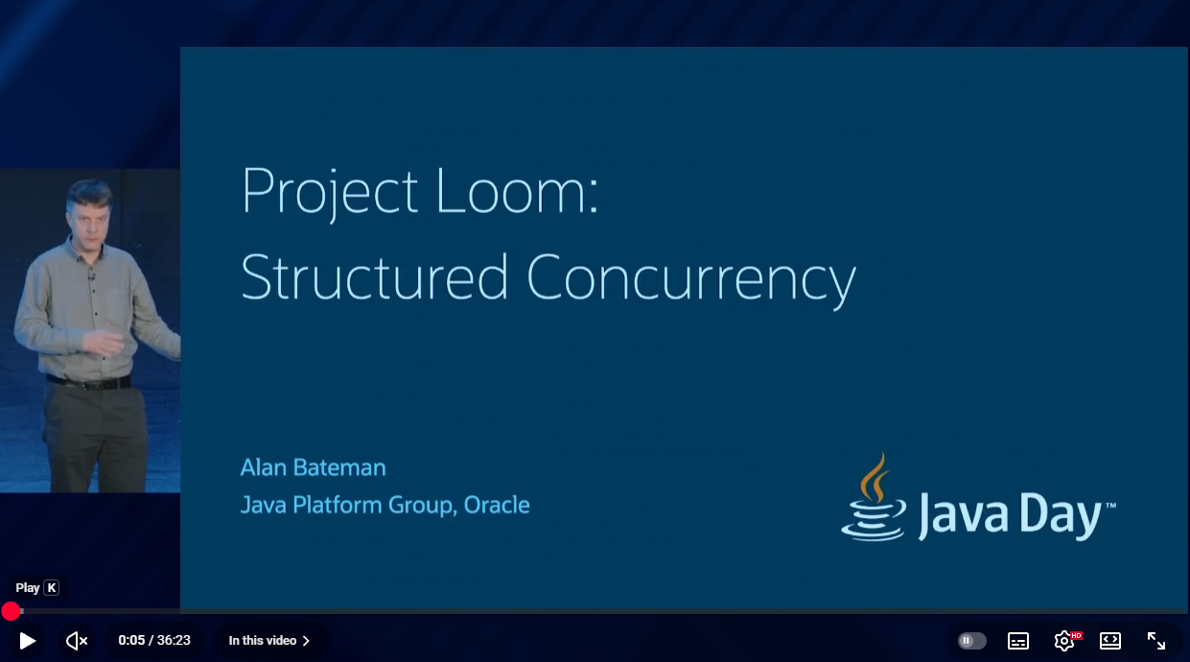
Project Loom: Structured Concurrency

Slide 65
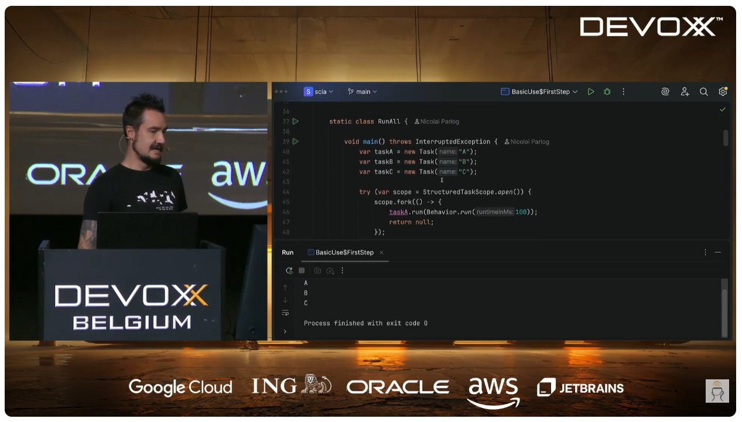
Structured Concurrency in Action by Nicolai Parlog

Slide 66

Virtual Threads, Structured Concurrency and Scoped Values: Putting it all together by Balkrishna R

Slide 67

Will Tollefson

Slide 68
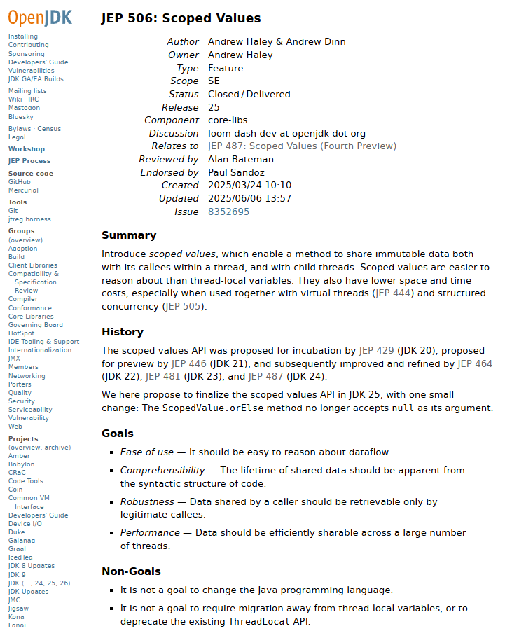
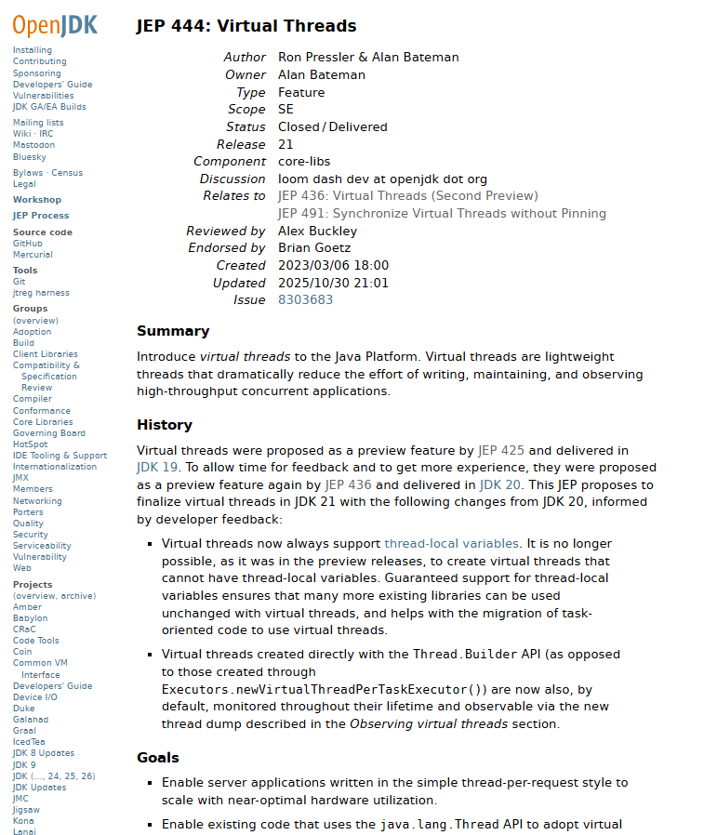
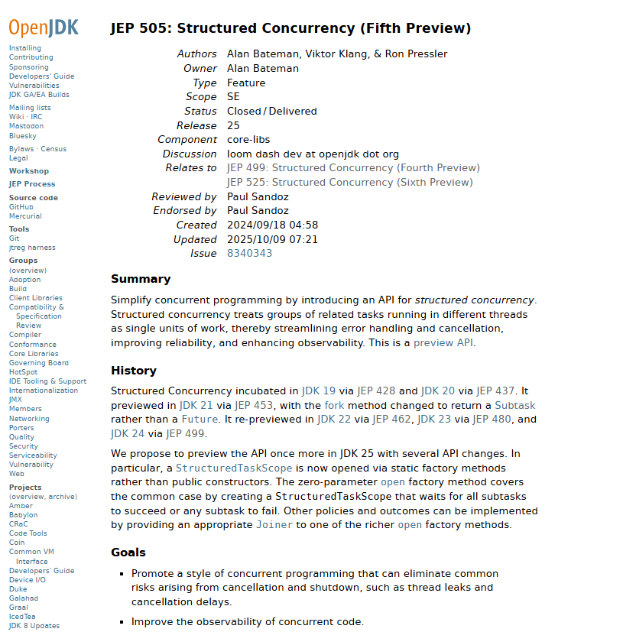
JEP

Slide 69
EXAMPLE REPOSITORIES
https://github.com/nipafx/scia
https://github.com/balkrishnarawool/SpringBootLoom

Slide 70
THANKS

